Slide 1
Movies
Barb Ericson
Georgia Institute of Technology
April 2006

Slide 2
Learning Goals
Media Goals
  To understand the psychophysics of movies
  To generate frame-based animations with simple geometric shapes, text, and images
  To do special effects on movies like chromakey
Computing Concepts
  To explain why movies take so much space
  To add parameters to methods to make them reusable
  To reuse earlier methods in making movies

Slide 3
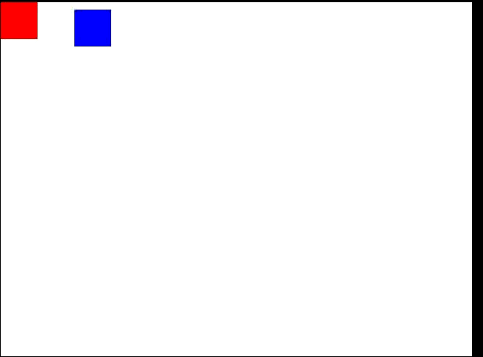
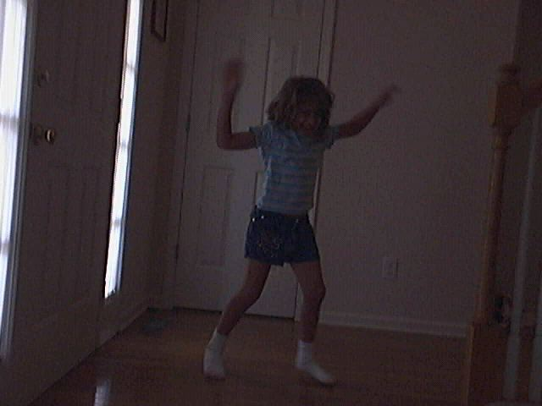
Movies, Animation, and Video … oh my!
We will refer to captured (recorded) motion as movies
  Including motion generated by graphical drawings, which is usually called animation
  And motion generated by some sort of photographic process, usually called video
Notes:
Click in the frame with the two rectangles in it to see the animation. The picture of the girl is from mediasources/kid-in-bg-seq/.

Slide 4
Psychophysics of Movies
What makes movies work is persistence of vision
  We don't notice when we blink
  Because we retain the last image we saw
  If not the world would "go away" when we blink
Have three people observe another person
  Don’t tell the person what is being counted
  Count how many times s/he blinks in two minutes
  Do the people who are counting agree?

Slide 5
Manipulating Movies
Movies are a series of pictures (frames)
  Like flip-book animation
The frame rate is the number of frames shown per second
  16 frames per second is the lower bound on our perception of continuous motion
    Silent movies were 16 fps
    Later the movie standard became 24 fps to work better with sound
    Digital video captures 30 frames per second
  Some people can tell the difference between 30 and 60 frames per second
    Air force studies show pilots can recognize something in 1/200th of a second

Slide 6
Storing Movies
One second of a 640 by 480 picture at 30 frames per second (fps) is
  640 * 480 * 30 = 9, 216,000 pixels
Using 24 bit color that means
  3 * 9, 216,000 = 27, 648, 000 bytes or over 27 megabytes per second
For a 90 minute film that is
  90 * 60 * 27,648,000 bytes = 149 gigabytes

Slide 7
Compressing Movies
A DVD only stores 6.47 gigabytes
  So movies are stored in a compressed format
Compressed formats
  MPEG, QuickTime, and AVI
    Don't record every frame
    They record key frames and then the differences between the frames
  JVM records every frame
    But each frame is compressed
Notes:
A MPEG movie is really a MPEG image sequence merged with a MPEG (MP3) audio file. MPEG is an international standard, from the same people who invented JPEG. AVI is a Microsoft standard. QuickTime is an Apple standard. JMV is a file consisting of JPEG frames in an array.

Slide 8
Generating Frame-Based Animations
We will make movies by
  Creating a series of JPEG pictures and then displaying them
Use a FrameSequencer
  To handle naming and storing the frames
    Using leading zeros to keep them in order alphabetically
  And displaying the movie from the frames
    Using the MoviePlayer class
Other ways to create a movie from frames
  Use QuickTime Pro http://www.apple.com/quicktime
  ImageMagick http://www.imagemagick.org/
Notes:
Both QuickTime Pro and ImageMagick can create a movie from a set of frames and create a set of frames from a movie. ImageMagick is free but only works on Windows machine.

Slide 9
Code for Rectangle Movie
public void makeRectangleMovie(String directory)
{
int framesPerSec = 30;
Picture p = null;
Graphics g = null;
FrameSequencer frameSequencer =
new FrameSequencer(directory);
frameSequencer.setShown(true);
// loop through the first second
for (int i = 0; i < framesPerSec; i++)
{

Slide 10
Code for Rectangle Movie - Cont
// draw a filled rectangle
p = new Picture(640,480);
g = p.getGraphics();
g.setColor(Color.RED);
g.fillRect(i * 10, i * 5, 50,50);
// add frame to sequencer
frameSequencer.addFrame(p);
}
// play the movie
frameSequencer.play(framesPerSec);
}

Slide 11

Rectangle Movie
Notes:
This mpeg file was created with ImageMagick using
convert –adjoin –border 1 –bordercolor black frame*.jpg frame.mpeg
Click on the movie to play it.

Slide 12
MovieMaker Class
Add the makeRectangleMovie to a new class MovieMaker
Use the following main to test it
  Set the directory to any empty directory
public static void main(String[] args)
{
MovieMaker movieMaker = new MovieMaker();
String dir = "c:/intro-prog-java/movies/rectangle/";
movieMaker.makeRectangleMovie(dir);
}
Notes:
Change the directory if you wish to store the frames in another location.

Slide 13
Out of Memory Error
We go through lots of memory when we make movies
  Java can run out of memory
You can specify how much memory to use
  In DrJava click on Edit->Preferences
    This displays the Preferences Window
      Select Miscellaneous under Categories
      Enter –Xmx512m –Xms128m to start with 128 megabytes and set the max to 512 megabytes
      Click on OK
      Click on Reset
  You can specify a maximum that is larger than the amount of RAM in your machine
    It will swap unused items to the disk (virtual memory)
Notes:
If you are using the command line tools from Sun you can specify the starting memory and maximum memory on the command line when you execute the main method in a class:
java –Xmx512m –Xms128m MovieMaker

Slide 14
How the Movie Works
The key part is
g.fillRect(i * 10, i * 5, 50,50);
The rectangle will be drawn at a different location on a blank picture each time
  And FrameSequencer will write out a file with the resulting picture in it
    With leading zeros in the name to keep them in order
The first few calls are
g.fillRect(0,0,50,50);
g.fillRect(10,5,50,50);
g.fillRect(20,10,50,50);
g.fillRect(30,15,50,50);

Slide 15
Exercise
Create a new method in MovieMaker
  makeOvalMovie
  Animate a filled oval moving from the bottom left of a 640 by 480 blank picture to the top right
  Allow the color and size of the oval to be specified as parameters to the method

Slide 16
Summary
Movies and video are a series of pictures
  Shown quickly one after the other
The frames rate is the number of frames shown per second
  Need at least 16 fps (frames per second)
  Digital Video is 30 fps
Movies take up quite a bit of space
  So they are stored in a compressed form

